Slide 1
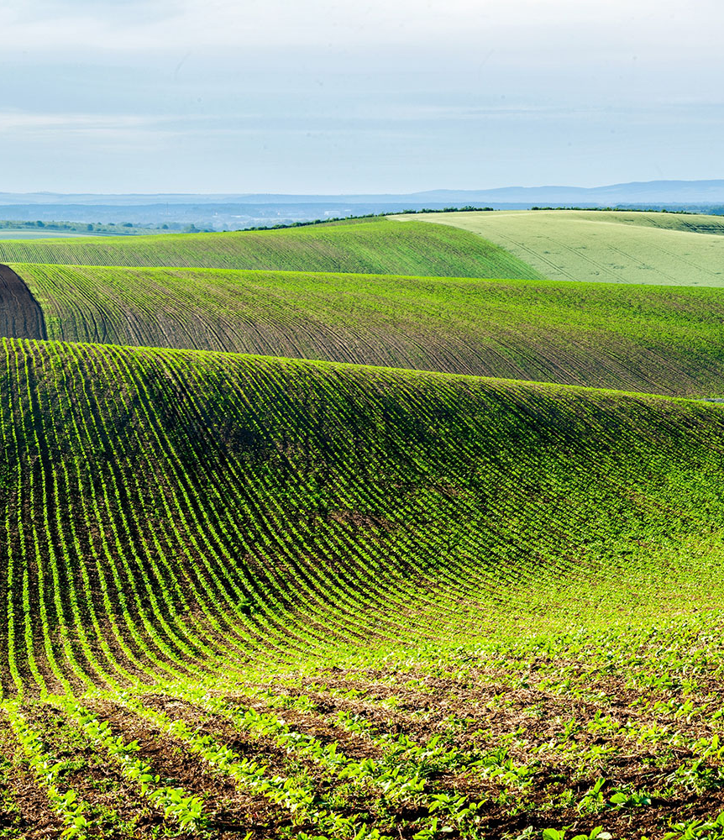

V AUTOMATORS
The Team:
VasanthaKumar M
Vikas J
Dhayanath S
Aravind A
EFFECTIVE WATER SOURCE MANAGEMENT FOR SMART FARMING

Slide 2
OBJECTIVE
Our project is to design an automatic water irrigation system that uses the method of drip irrigation. We have chosen this method as it is very water conservative and costs comparably less than other conventional methods.
The whole setup utilizes various sensors that provide the user with accurate readings about the condition of the crop. The user also has the ability to choose between manual control over watering the crops, or he/she will be able to pre-set the required actions so that its done automatically.
The overall most significant benefit of using this system is that a heavy burden is lifted off the shoulders of the user as the system takes over. This method will also reduce the wastage of water, and at the same time, provide us with maximum yield.
The maintenance of this system is considerably easy and costless as the sensors used are rugged and built to withstand harsh conditions.
CONSERVATIVE
ACCCURATE
EASY TO USE
MAINTAINABLE
COMPARITIVELY COSTLESS

Slide 3
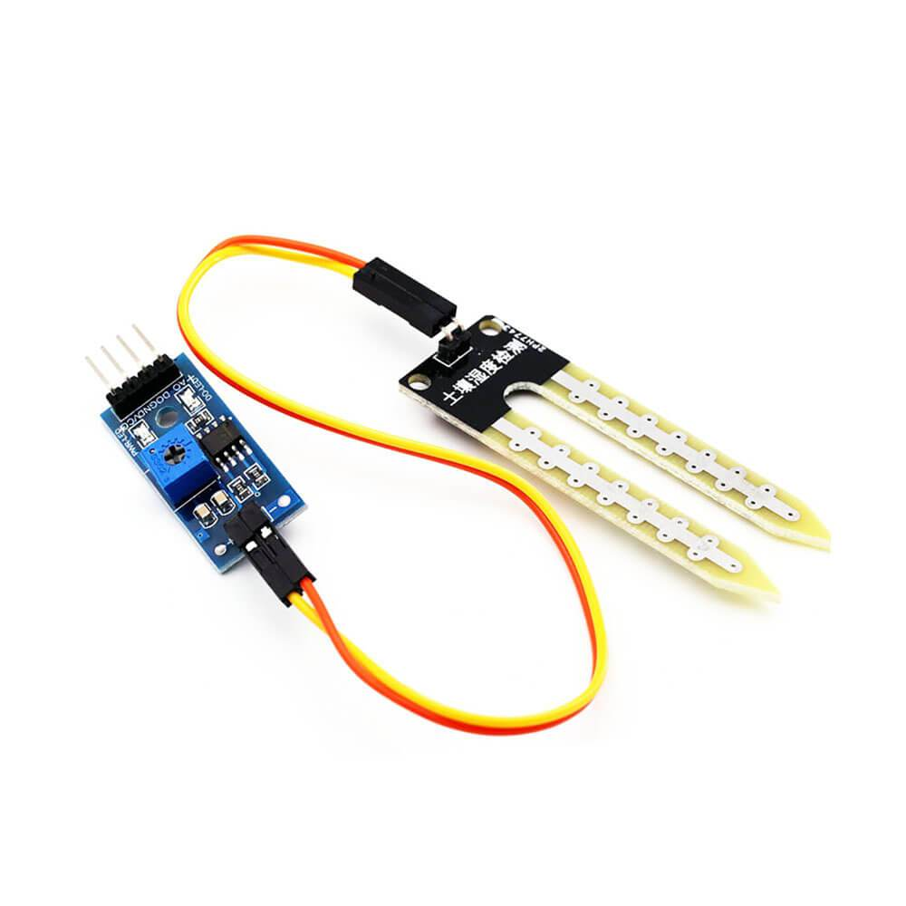
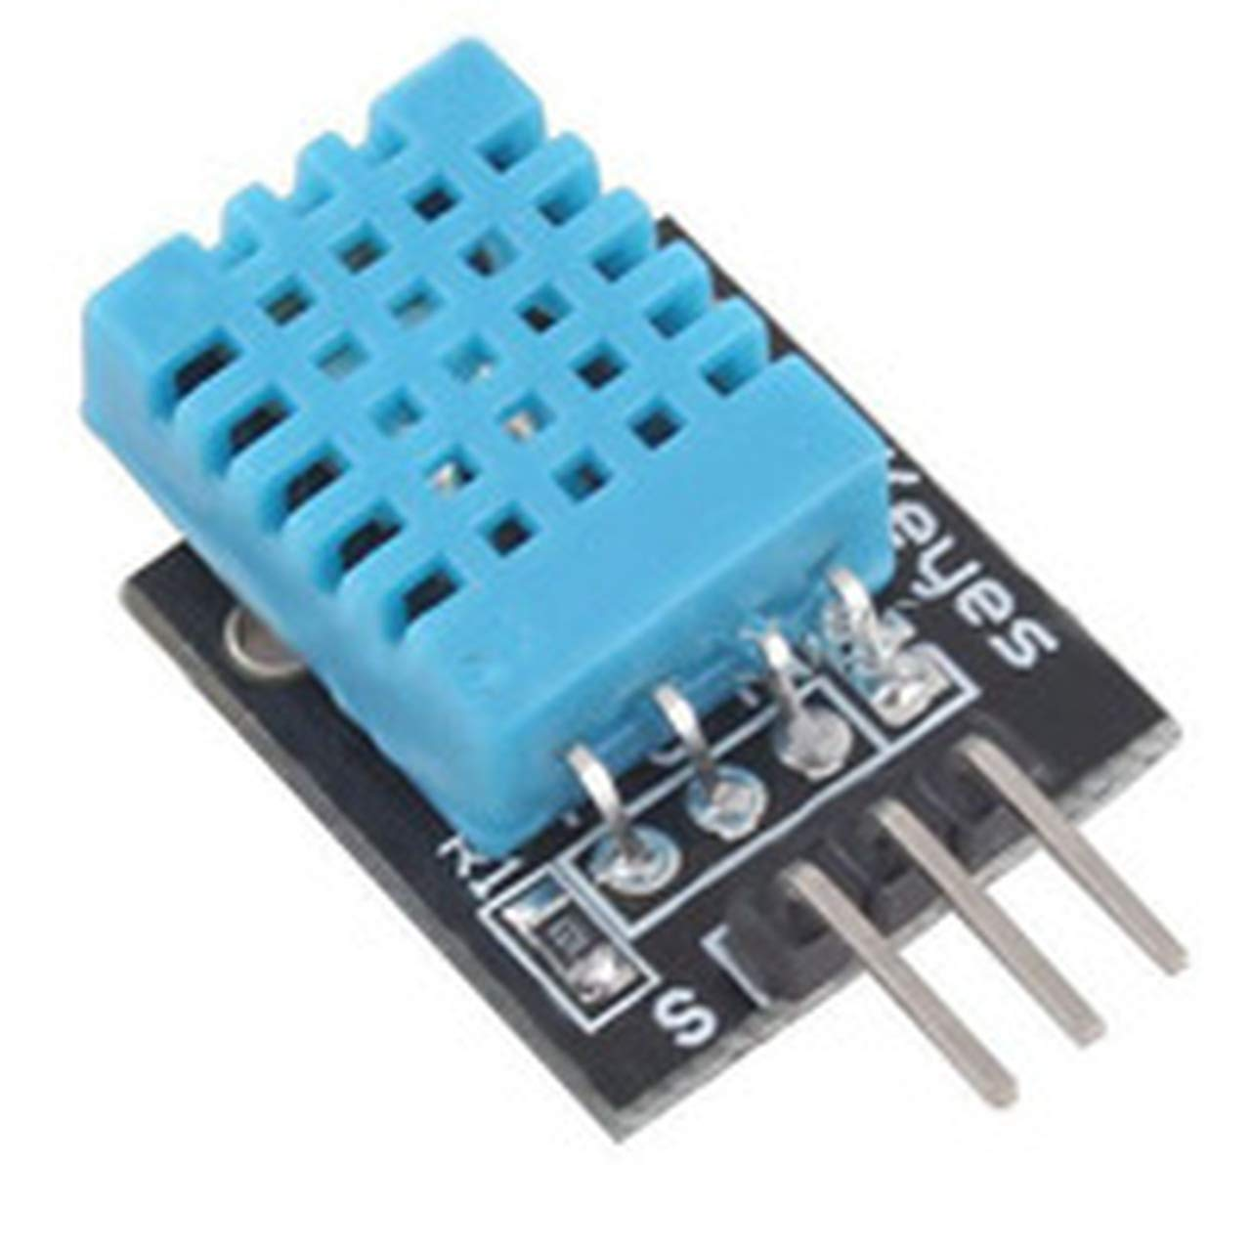
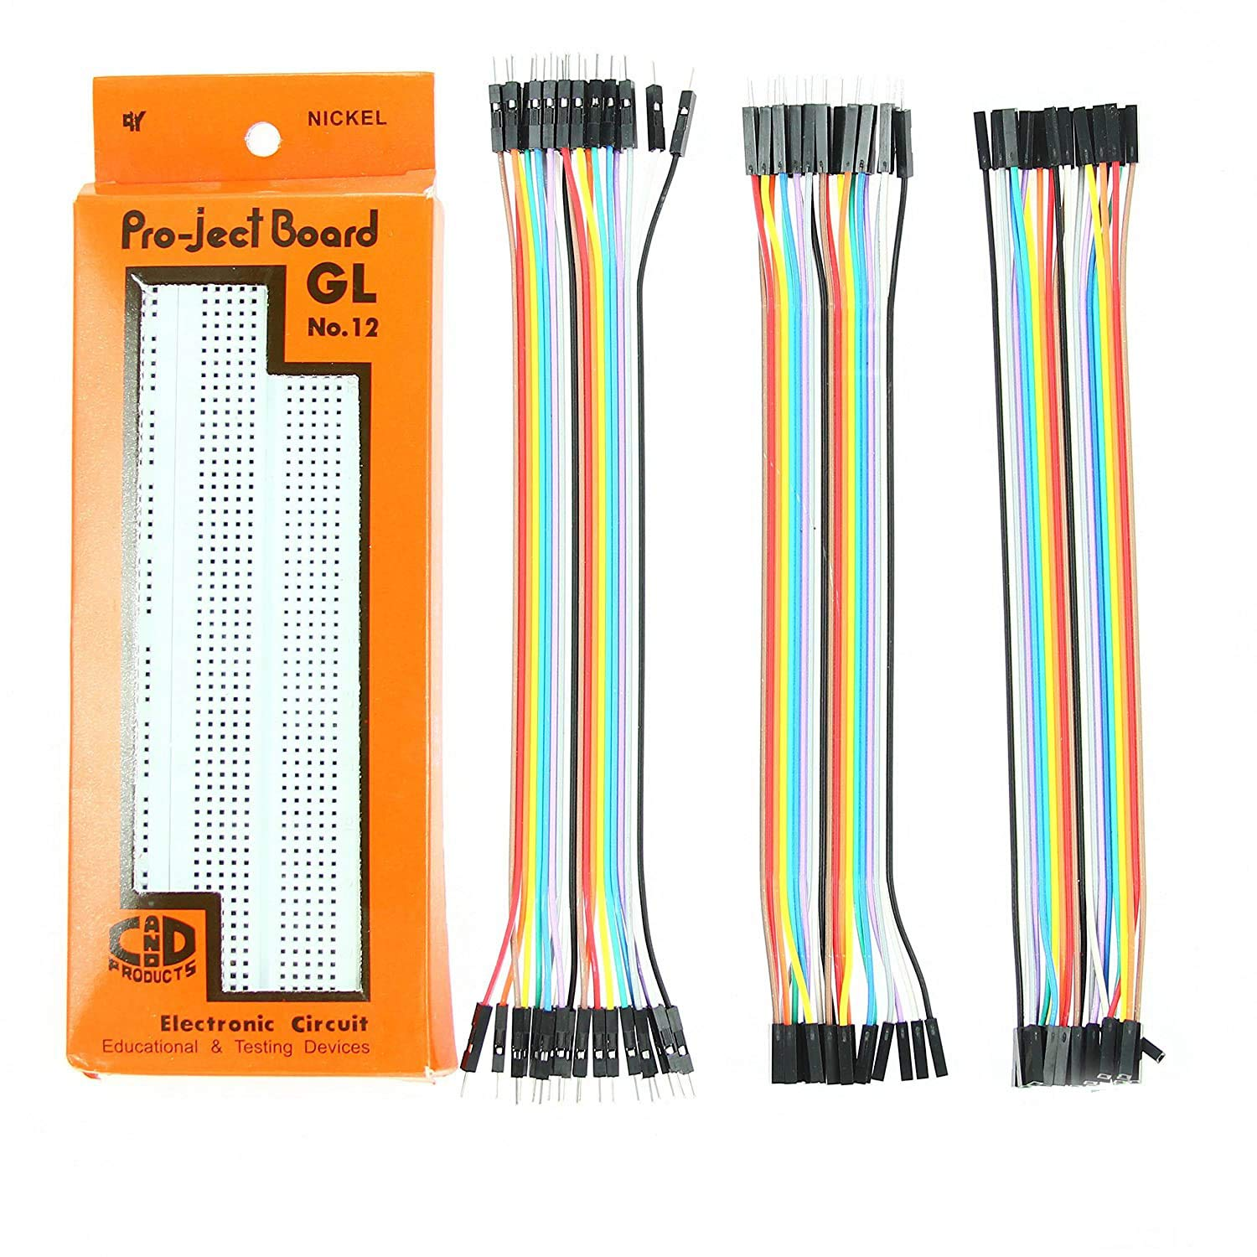
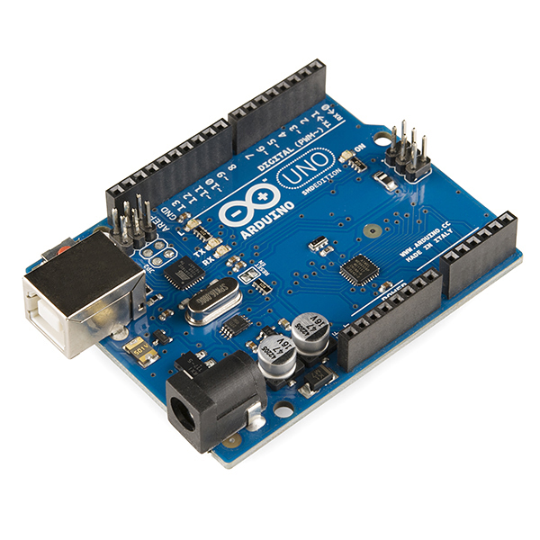
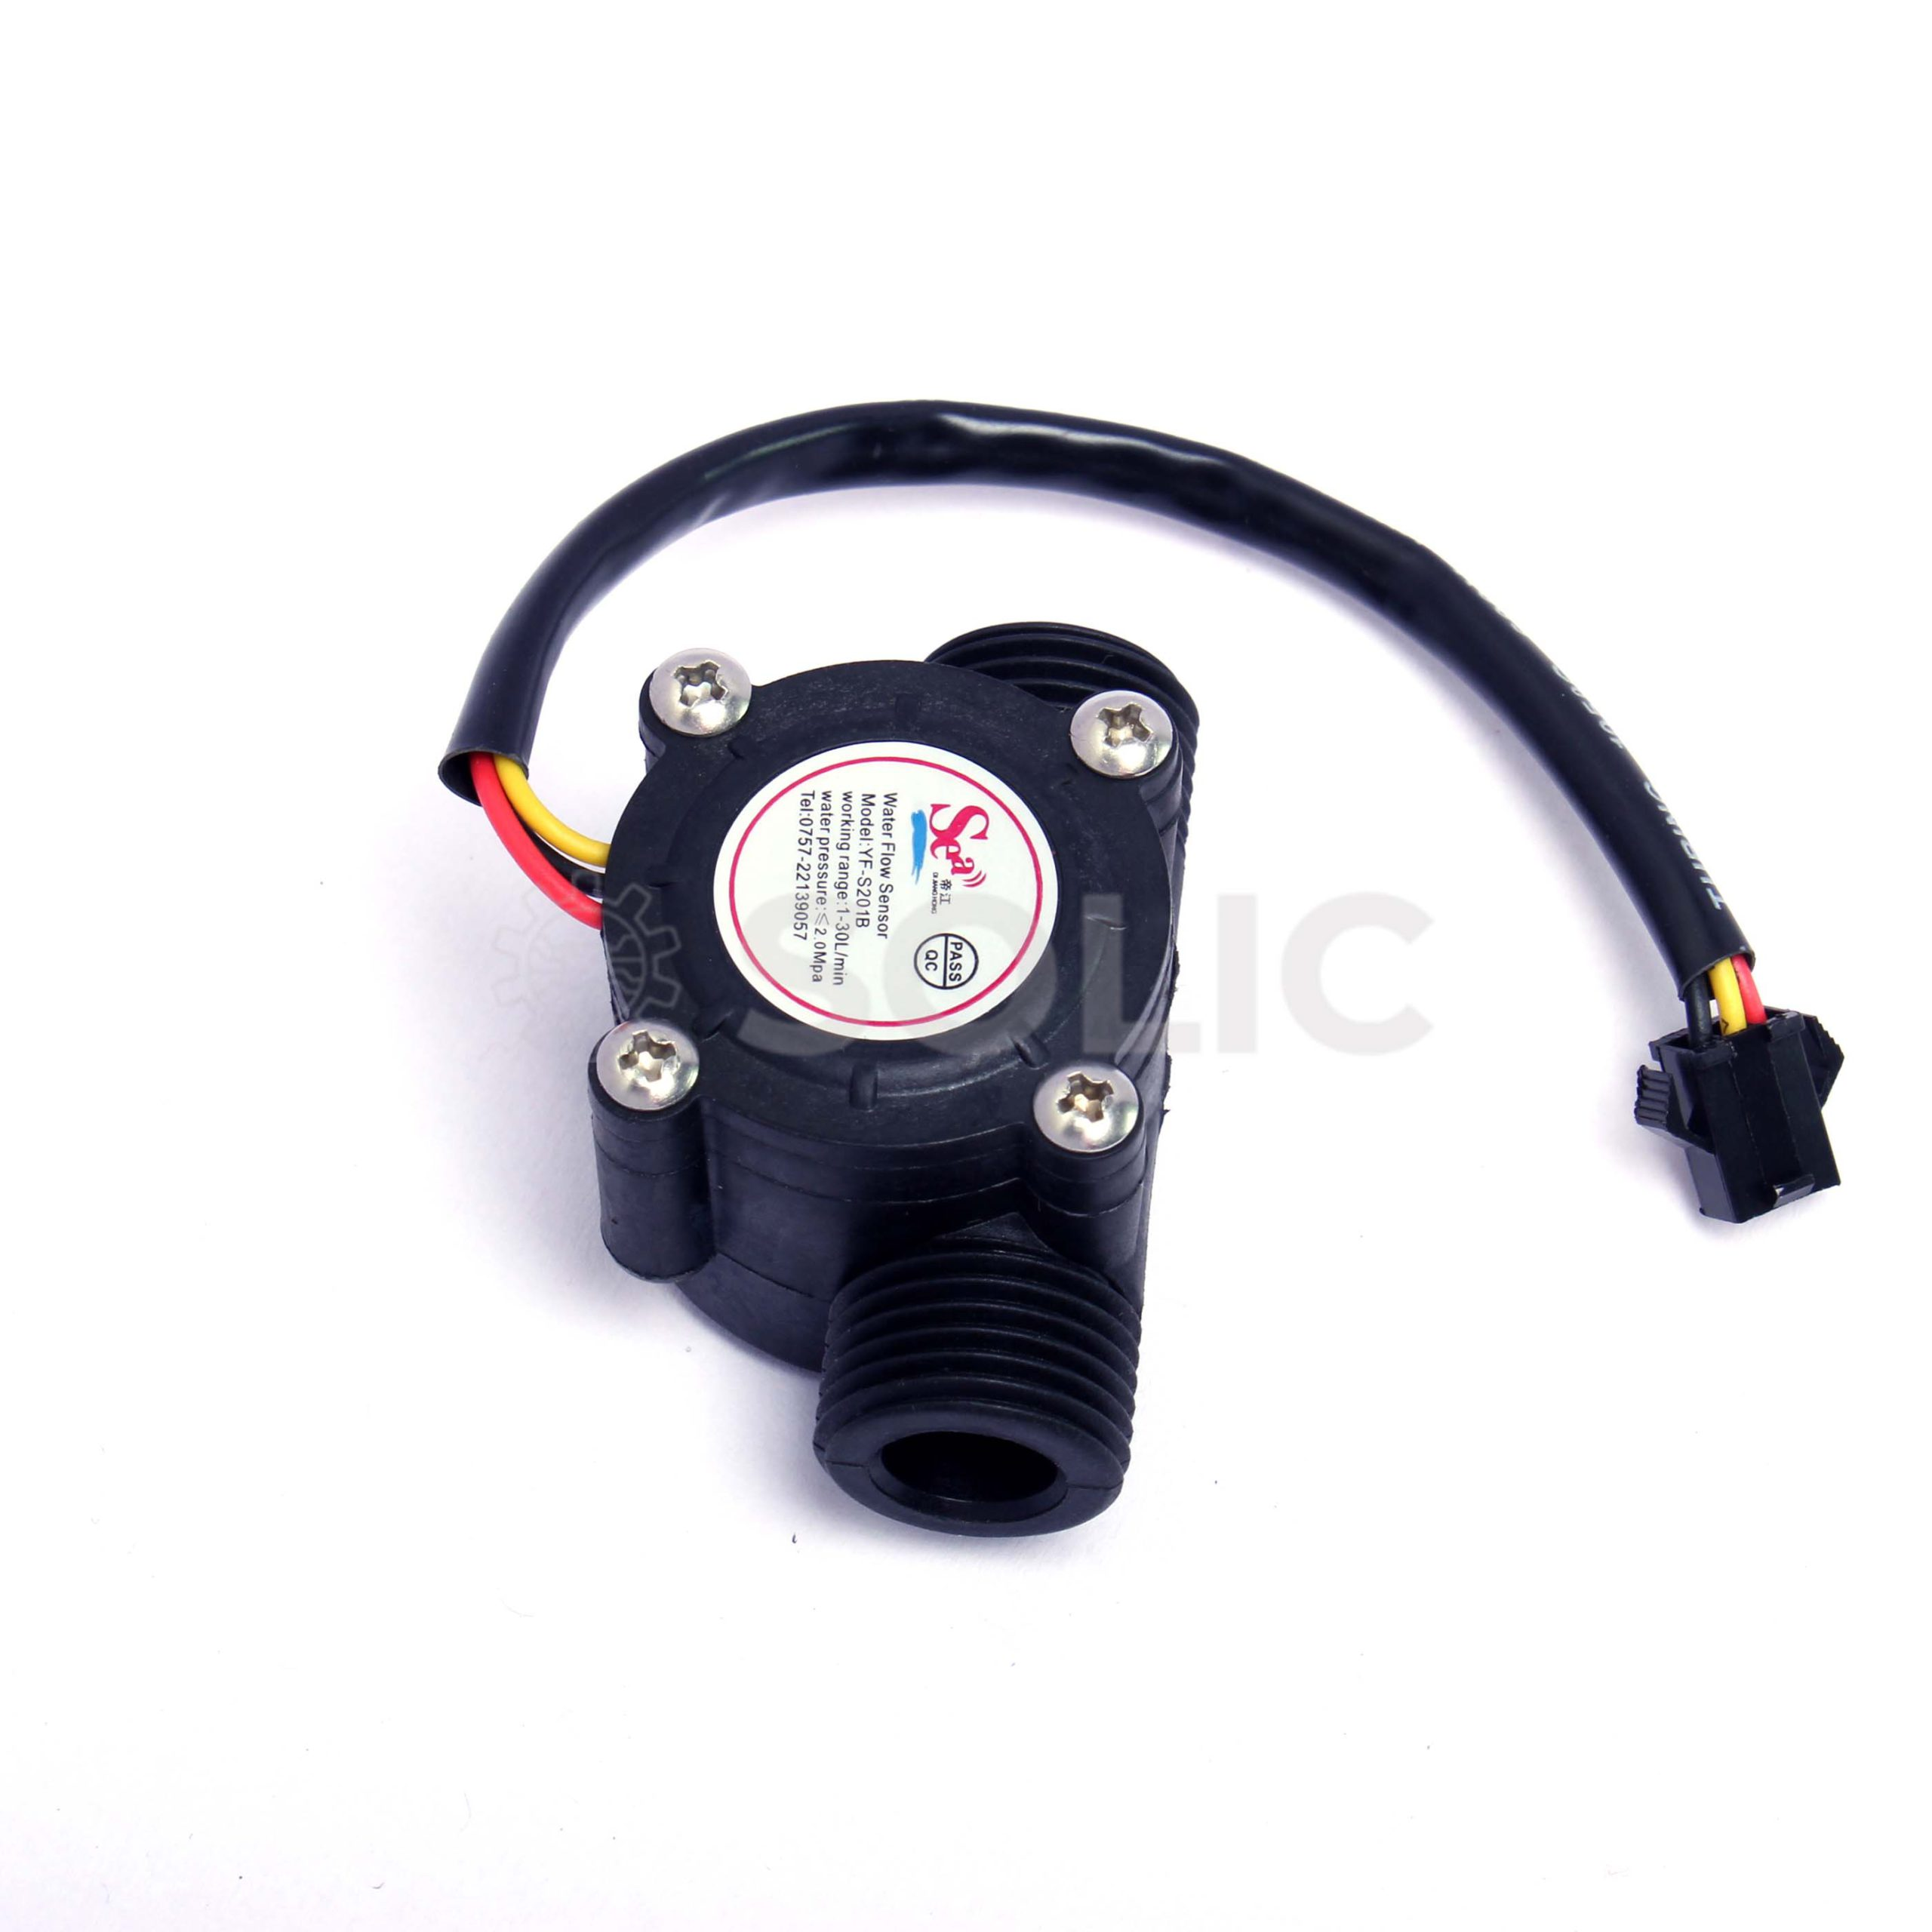
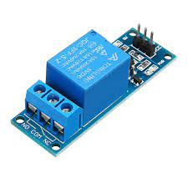
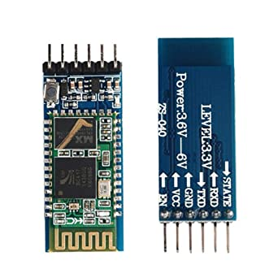
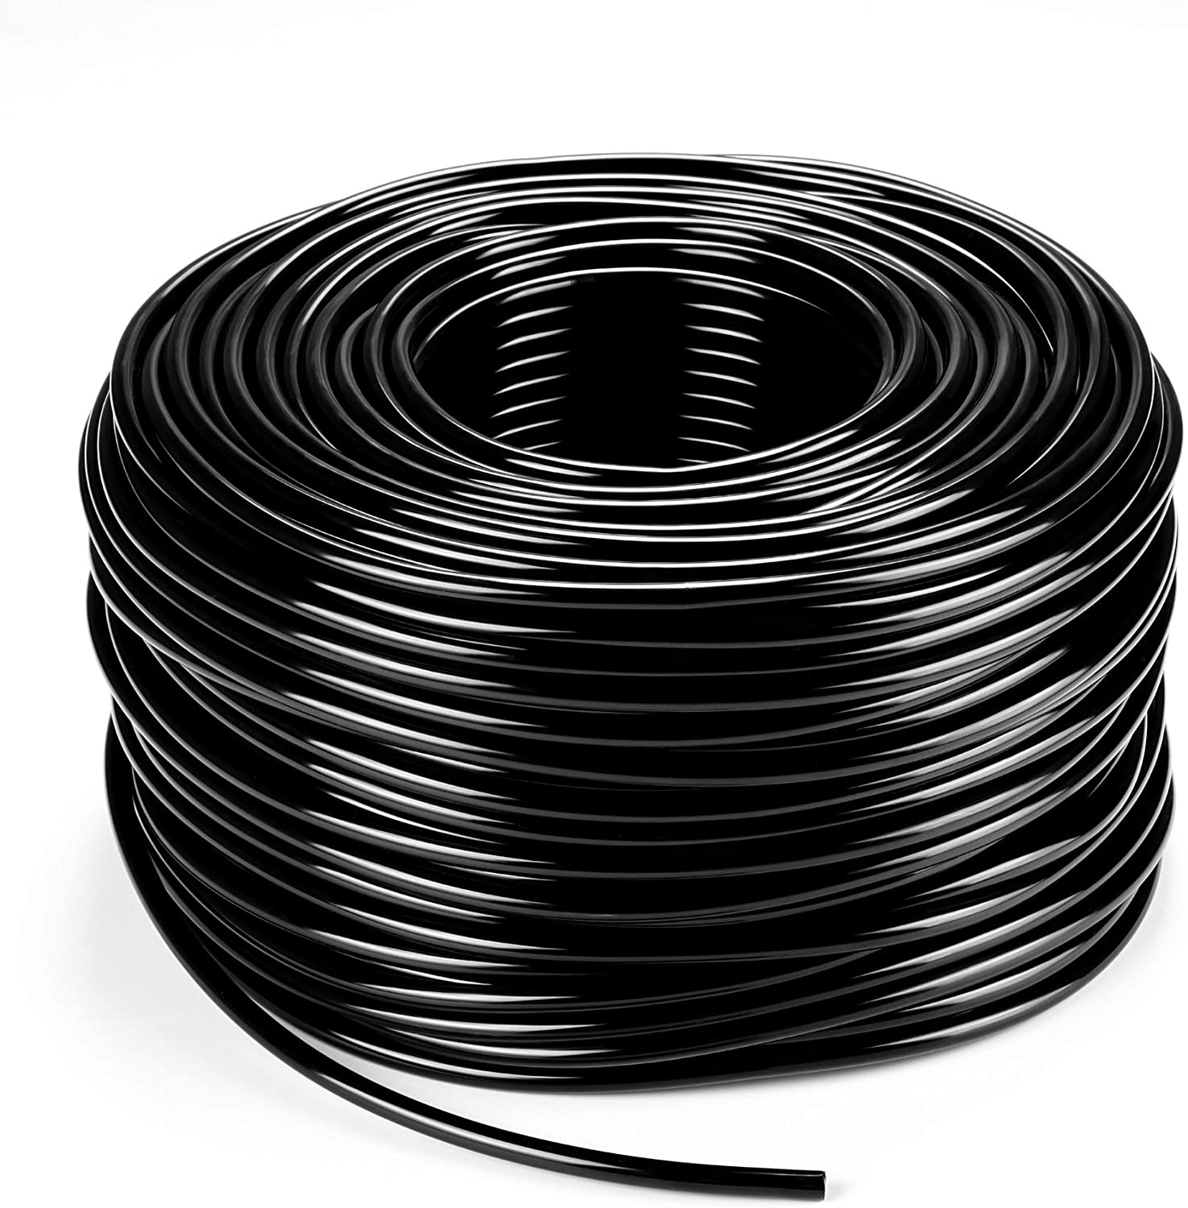
SYSTEM COMPONENTS
SOIL MOISTURE SENSORS
DHT 11 SENSORS
BREADBOARD AND WIRES
ARDUINO UNO
WATER FLOW SENSOR
RELAY MODULE
BLUETOOTH MODULE
DRIP TUBES

Slide 4
IMPLEMENTATION
The existing drip irrigation system is close to perfect as it doesn’t involve much components. But, the scope for making the system better is still open.
The most common problems faced during the use of drip irrigation are the blocking of the thin tubes by dirt and algae and the effective cover area from the source.
This method insures the uninterrupted supply of water. The rest of the setup is just like the existing models, but we must take precautions here too.
The main features and benefits of this system include:
Continuous monitoring of soil moisture and automatic watering when moisture is low.
Monitoring of temperature and humidity.
Water leak monitor notifies when water is being used when its not supposed to.
Automatic watering of crops at optimal time selected by the user.
Both automatic and the manual control of water
.

Slide 5
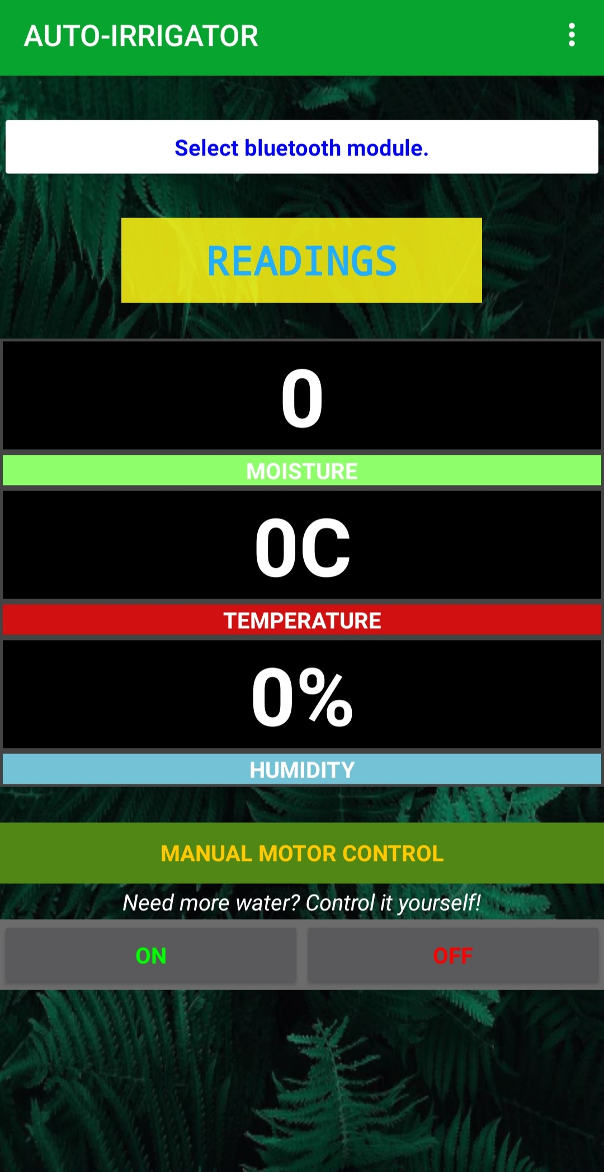
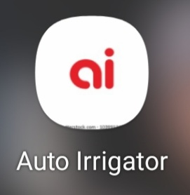
IMPLEMENTATION
AUTO IRRIGATOR APP INCLUDES:
Connecting the Bluetooth
Selecting the Bluetooth module
Displaying Moisture, temperature and humidity measurements
Automatic control
Manual control
ON and OFF button to control the motor pump

Slide 6
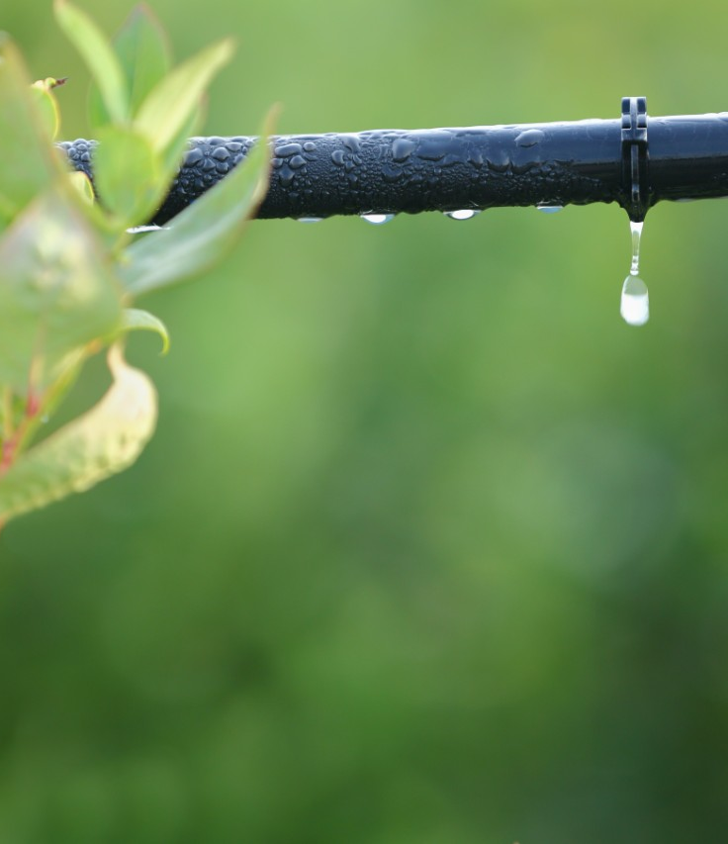
Thank You.

